Slide 1
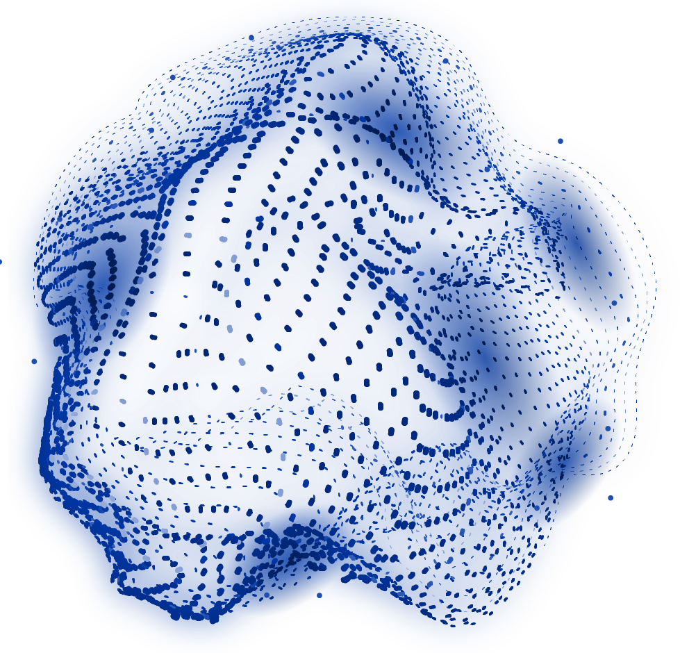


ARTIFICIAL INTELLIGENCE (AI)
PROJECT PROPOSAL
“RETAIL PRICING STRATEGIES”

Slide 2


PROBLEM STATEMENT :
“Optimizing Personalized Pricing For Different Customer Segments”

Slide 3
OUR ASPIRATIONS
PROBLEM CONTEXT
IMPACT ON INDUSTRY
The retail industry is undergoing significant transformation due to technological advancements, evolving customer expectations, and increased competition. Retailers must constantly adjust pricing strategies to maximize revenue, remain competitive, and satisfy customer expectations.
Balancing profitability with customer satisfaction is crucial for the retail industry, as overpricing can reduce sales, underpricing can harm brand reputation, and erode market adaptability.

Slide 4
PROBLEM SOLVING APPROACHES
Problem-Solving Solutions and Approaches:
Fixed Pricing Models | Traditional pricing strategies rigidly based on set rules, not adaptable to customer behavior or market fluctuations.
Adaptive Pricing Algorithms | Real-time price adjustments based on factors like inventory levels, demand trends, and competitor prices.
Customized Pricing | Machine learning techniques personalize prices based on customer data, raising concerns about data privacy and fairness.
Revenue Optimization Techniques | Linear programming or reinforcement learning balance profit maximization and customer retention, requiring high computational resources.
Psychological Pricing Insights | Understanding psychological factors influencing customer purchasing decisions.
Integrated Pricing Models | Combining dynamic pricing with consumer psychology insights for a holistic strategy.

Slide 5
STRENGTHS AND LIMITS OF SOLUTION:
Solution
Fixed Pricing Models:
Adaptive Pricing Algorithms:
Customized Pricing:
Revenue Optimization Techniques:
Strengths
Limitation
Simple, consistent, lacks flexibility.
Lacks flexibility and does not adapt to customer
Real-time price adjustments based on market conditions.
Can lead to customer dissatisfaction
and requires complex data management.
Tailors prices to individual customer segments.
Raises data privacy concerns and can be seen as unfair by customers.
Balances profitability and customer retention.
Computationally intensive and data-dependent, requiring ongoing adjustments.
Psychological Pricing Insights:
Boosts sales
Hard to quantify and can be seen as manipulative if overused.
Combines multiple pricing strategies for a more adaptive solution.
Complex to implement and resource-intensive to maintain.
Integrated Pricing Models:

Slide 6
WHAT WE WORKED ON…
LIBRARIES
DATASETS
TOOLS & TECHNIQUES
Pandas, numpy, cikit-learn, matplotlib, seaborn, os, datetime.
https://archive.ics.uci.edu/ml/machine-learning-databases/00352/Online%20Retail.xlsx
Data cleaning, RFM analysis, clustering, dynamic pricing, data standardization, and visualization.

Slide 7
—GitHub Link
https://github.com/Nisarg-Pandyaa/pentagon

Slide 8
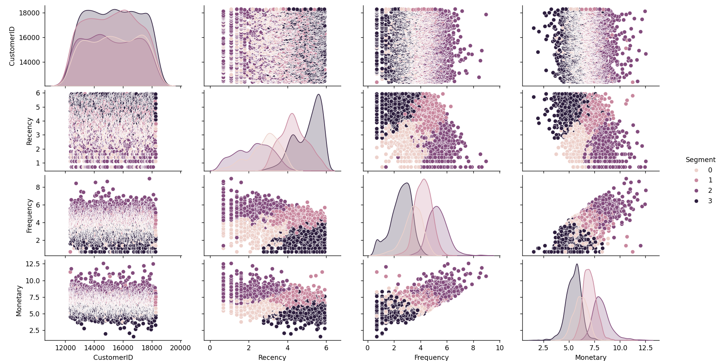
OUTPUT:

Slide 9
ANALYSIS OF OUTPUT
Key Observations:
1.)Axes:
•The diagonal plots are Kernel Density Estimation (KDE) plots showing the distribution of individual variables: CustomerID, Recency, Frequency, and Monetary.
•The off-diagonal plots show scatter plots for pairwise relationships between these variables.
2.)Variables:
•CustomerID : Likely represents unique customer identifiers, plotted for indexing purposes.
•Recency: Measures how recently a customer made a purchase. Lower values indicate more recent purchases.
•Frequency: Reflects how often a customer makes purchases.
•Monetary: Represents the total monetary value spent by a customer.
3.)Segment:
•The data is color-coded by a Segment variable (values 0, 1, 2, 3), which suggests customer segmentation derived from techniques like K-means clustering or other clustering algorithms.

Slide 10
Observations from the Pairwise Relationships:
4.)Graph Structure:
•Diagonal KDE Plots: Show the distribution of each variable for the different segments.
•Scatter Plots: Pairwise relationships between variables (e.g., Recency vs. Frequency, Frequency vs. Monetary) for the different customer segments.
1.)Recency vs. Frequency:
•There seems to be a negative relationship for some segments: customers who shop more frequently tend to have lower recency values.
•Clusters overlap but are partially distinguishable by their frequency values.
2.)Frequency vs. Monetary:
•A positive correlation is evident: customers who shop more frequently tend to spend more.
•Segments are separated here more clearly, with higher spending associated with specific clusters.
3.)Recency vs. Monetary:
•Customers who purchase more recently also seem to spend more, but the correlation is weaker compared to frequency.

Slide 11
Segmentation Insights:
->Segment 0 (light pink): Likely represents low-value customers with higher recency values (shop less frequently).
->Segment 1 (light purple): Possibly mid-value customers, balanced across recency and monetary values.
->Segment 2 (darker purple): High-frequency shoppers with moderate spending.
->Segment 3 (darkest purple): High-value customers who spend the most and shop most frequently.
Graph Interpretation:
•The KDE plots indicate how the segments differ in their distributions for each variable.
•The scatter plots help visualize the relationships between variables and how the clusters (segments) are separated in the feature space.

Slide 12
THANK YOU
BY:
- Nisarg Pandya
- Tanish Gupta
- Manan Joshi
- Tilak Sharma
- Krishna Shrivastava

